Slide 1
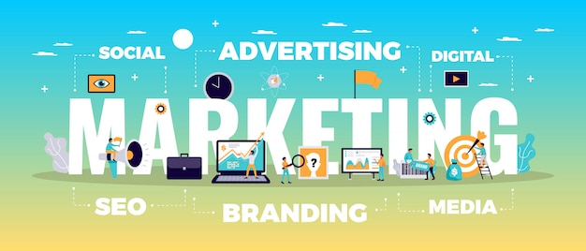

Slide 2

Comprehensive Digital Marketing Project Work
- by Satya Siva Shankar

Slide 3


Slide 4

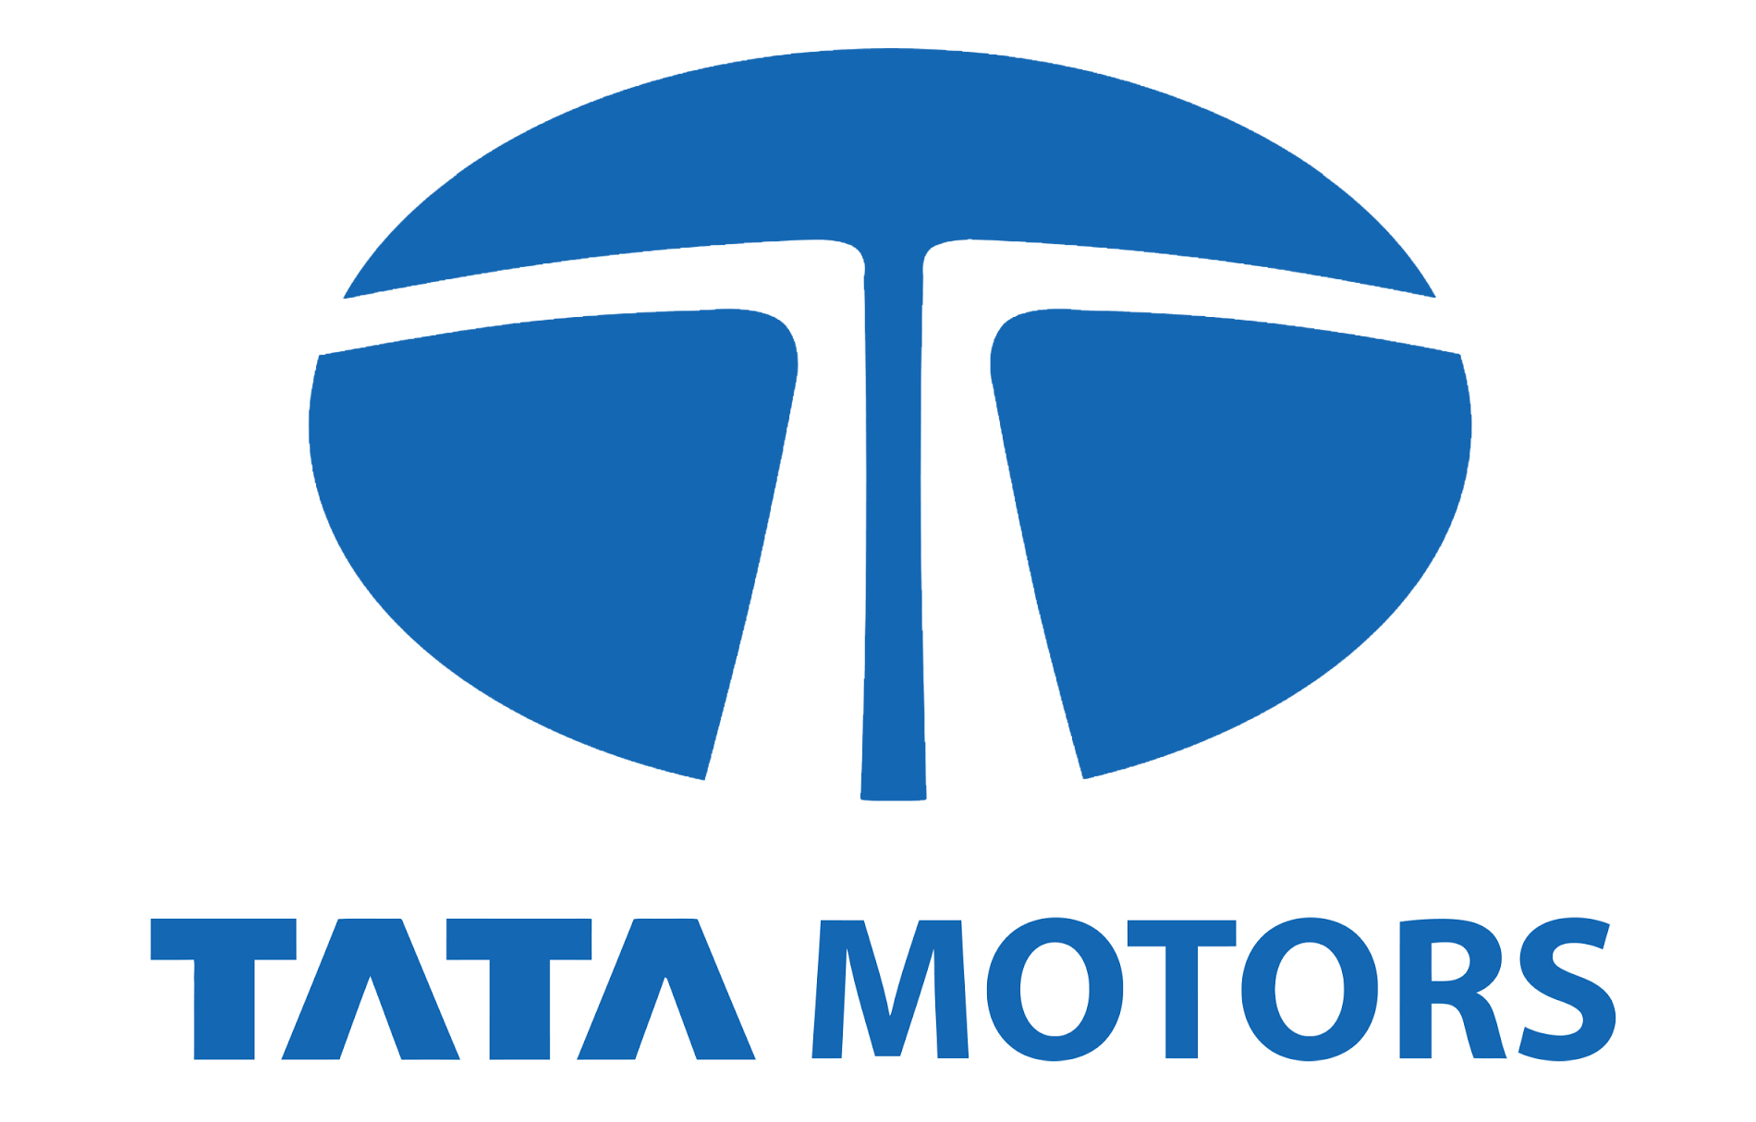
Part 1: Brand study, Competitor Analysis & Buyer’s/Audience’s Persona
Company : TATA MOTORS
Research Brand Identity:
LOGO :
Tata Motors Limited is an Indian multinational automotive manufacturing company, headquartered in Mumbai, India, which is part of the Tata Group. The company produces passenger cars, trucks, vans, coaches, and buses

Slide 5

Vision : To deliver value through our products and services and to be the most trusted global network for our customers and suppliers. To be a responsible value-creation partner for all stakeholders. To innovate mobility solutions with a passion to enhance the quality of life.
MISSIONS & VALUES :
“To Deliver Value through our Products and services and to be the most trusted global network for our customers and suppliers. To be a responsible value-creation partner for all stakeholders.”
USP ( UNIQUE SELLING PREPOSITIONS ) :
Tata Motors took a risk by emphasising safety as a selling point. They recognised that the strength and safety of a vehicle should be the top priority for car buyers. Tata aimed to disrupt the market dominated by Maruti by introducing safety as their unique selling proposition (USP).

Slide 6

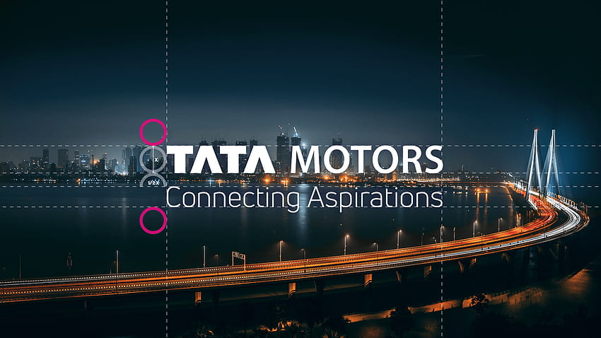
Analyze Brand Messaging:
“Leadership with Trust”
Examine the brand's tagline:
“Connecting Aspirations”
It is a symbolic tagline that is representative of the past, present and future

Slide 7

Competitor Analysis :
Competitor 1: VOLKSWAGON
USP :
Keeping Volkswagen brand's core USP of build quality, safety and fun to drive element each of these carlines will democratize the market in their respective segments.
https://www.volkswagen.co.in/en.html

Slide 8
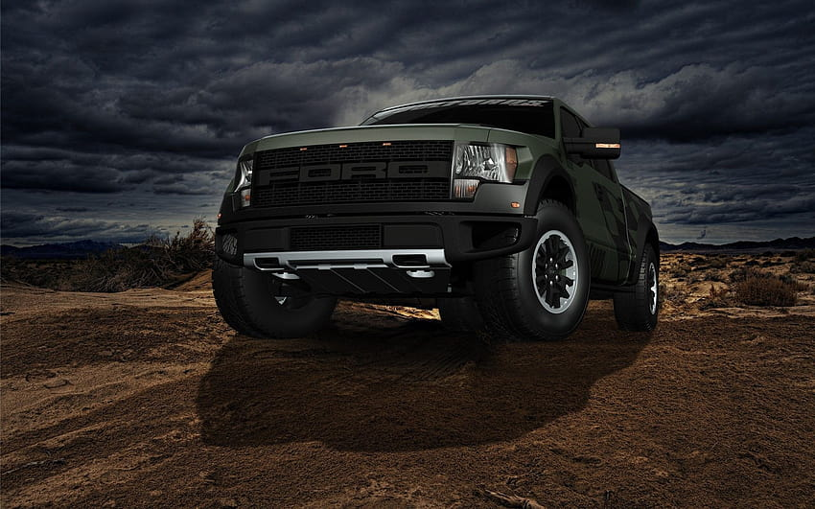
Competitor 2 : FORD
USP :
Ford has an international brand presence due to one of the oldest car manufacturing company and also provides a wide range of cars
https://www.india.ford.com/

Slide 9

USP : The company has established a reputation for quality, craftsmanship and reliability, and regularly wins praise in Europe for its unique Five Year Unlimited Mileage Warranty. But the main reason customers choose Hyundai cars is design.
Competitor 3 :
HYUNDAI
https://www.hyundai.com/in/en

Slide 10
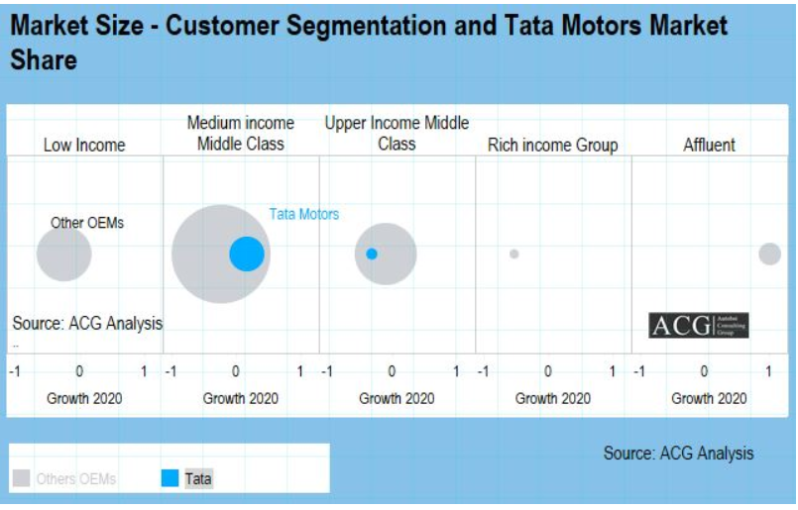
Part 1: Brand study, Competitor Analysis & Buyer’s/Audience’s Persona
Buyer's/Audience's Persona:

Slide 11
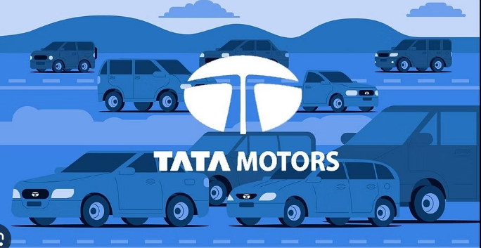
Buyer's/Audience's Persona :
TATA MOTORS :
21-65 yrs
Men / Women
Metro cities like Delhi,Mumbai etc
Not Remote Villages
Above 4,00,000 per annum
Ads by the website like GoMechanic, Youtube , Social Media Platforms
Tata stands for Vocal for Local

Slide 12
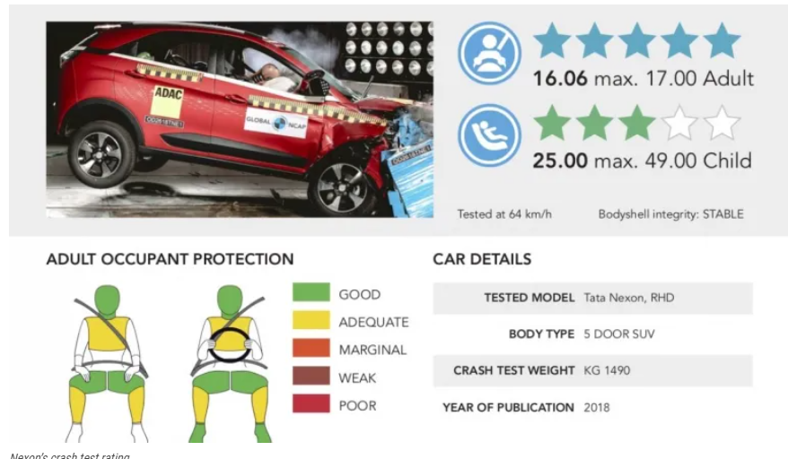
Tata Cars are SAFE
Tata Cars are competitively priced
Tata Cars are Muscular!
TATA is a built upon a legacy

Slide 13

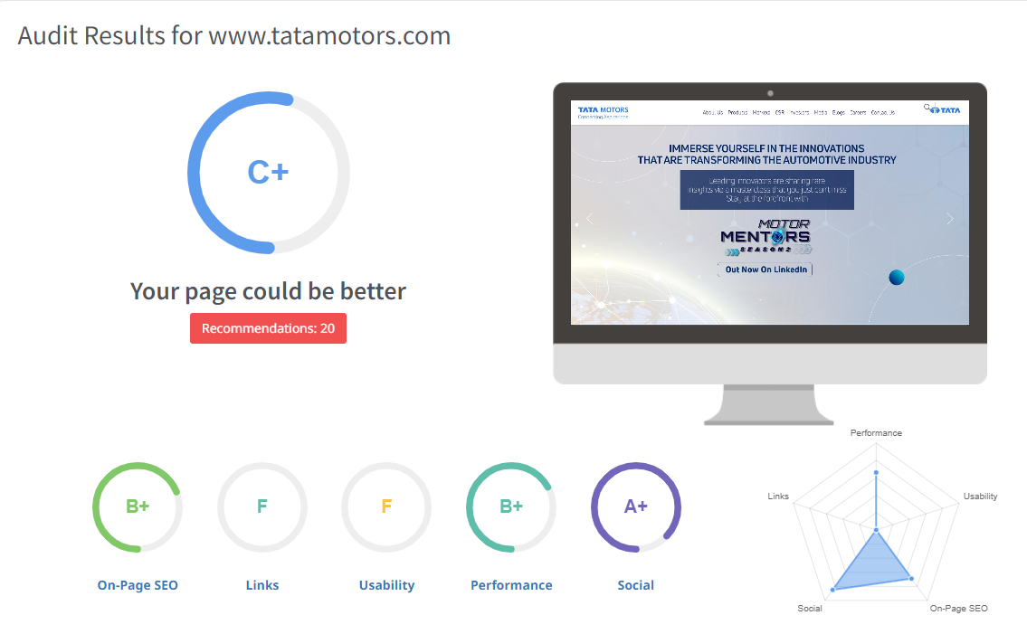
Part 2: SEO & Keyword Research
SEO Audit:
An SEO audit is the process of evaluating how well your website is optimized for search engines. It identifies errors that can prevent your site from ranking well and opportunities that can help you rank better.

Slide 14
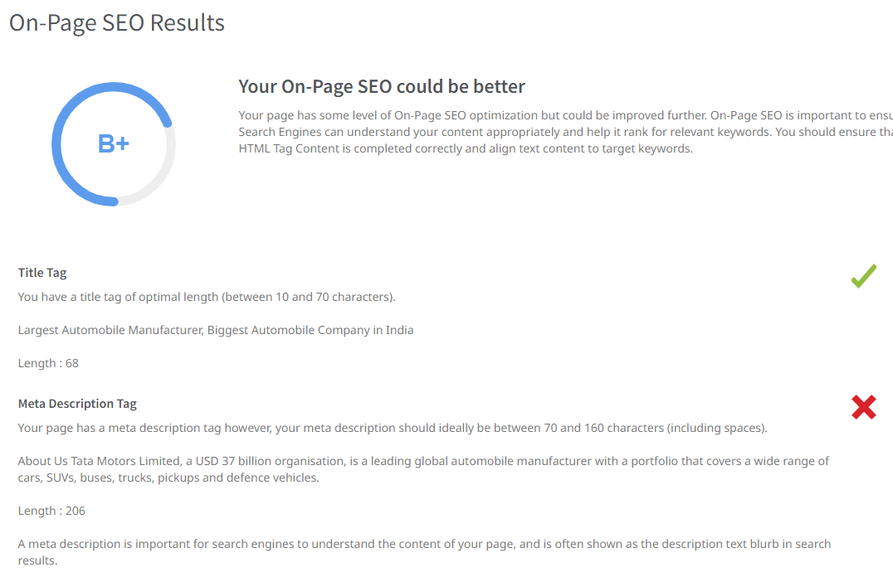

Slide 15
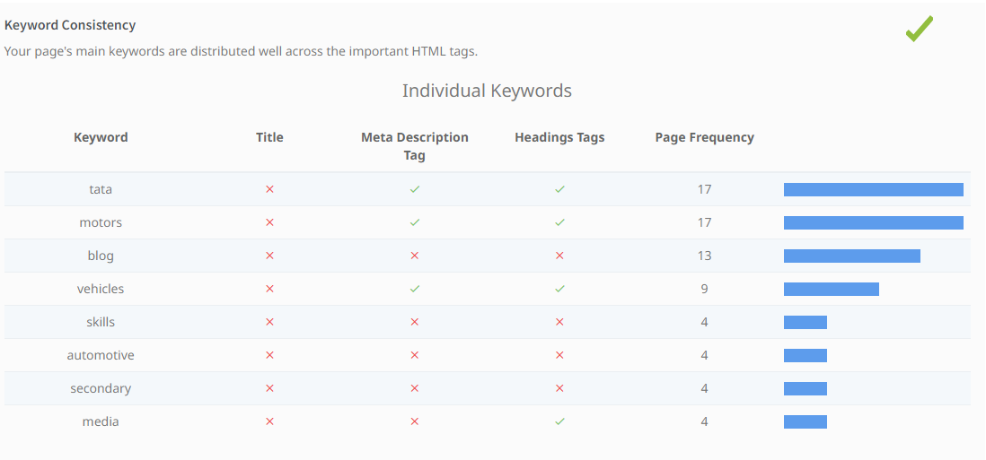
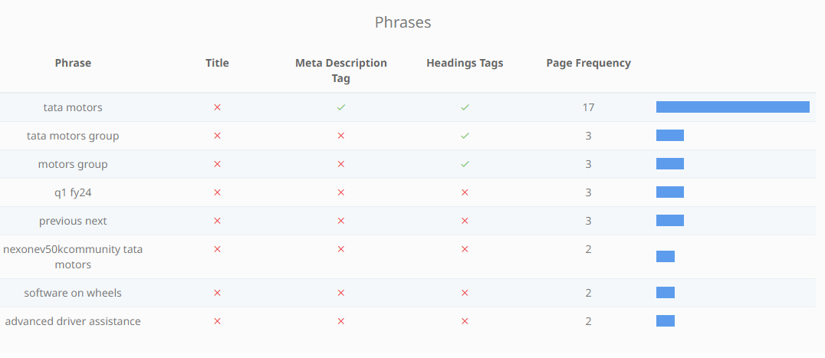

Slide 16
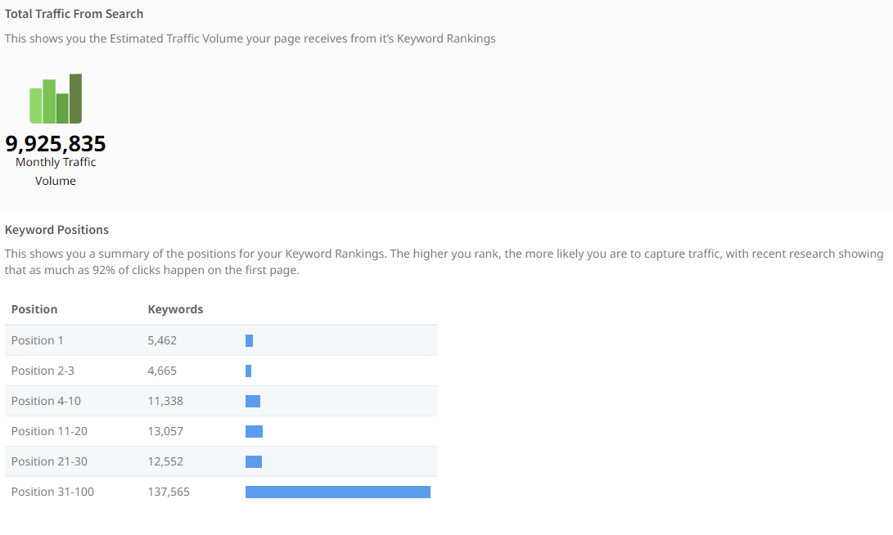

Slide 17

KEYWORD RESEARCH :
share price of tata motors
tata ev car
tata motors cars
tata all cars
tata cars list
tata upcoming cars
tata car price
tata upcoming cars
tata cars price list
tata cars 7 seater

Slide 18

Marketing Strategy :
Digital marketing: Tata Motors uses digital marketing channels to reach its target audience. The company uses social media, search engine marketing, and email marketing to promote its products and services.
Content marketing: Tata Motors creates engaging and informative content related to its products, such as videos, blog posts, and infographics. This content is published on the company's website and social media channels, and it helps to build brand awareness and establish the company's authority in the industry.
Increase brand awareness ,Generate leads , Drive sales , Build customer loyalty
Content Idea :
The company's website has a blog section where it publishes articles about its products, industry trends, and customer stories.
Tata Motors' social media channels feature a mix of videos, images, and text content that is designed to entertain, inform, and engage its followers.
The company also produces a variety of video content, such as product overviews, how-to videos, and customer testimonials.

Slide 19
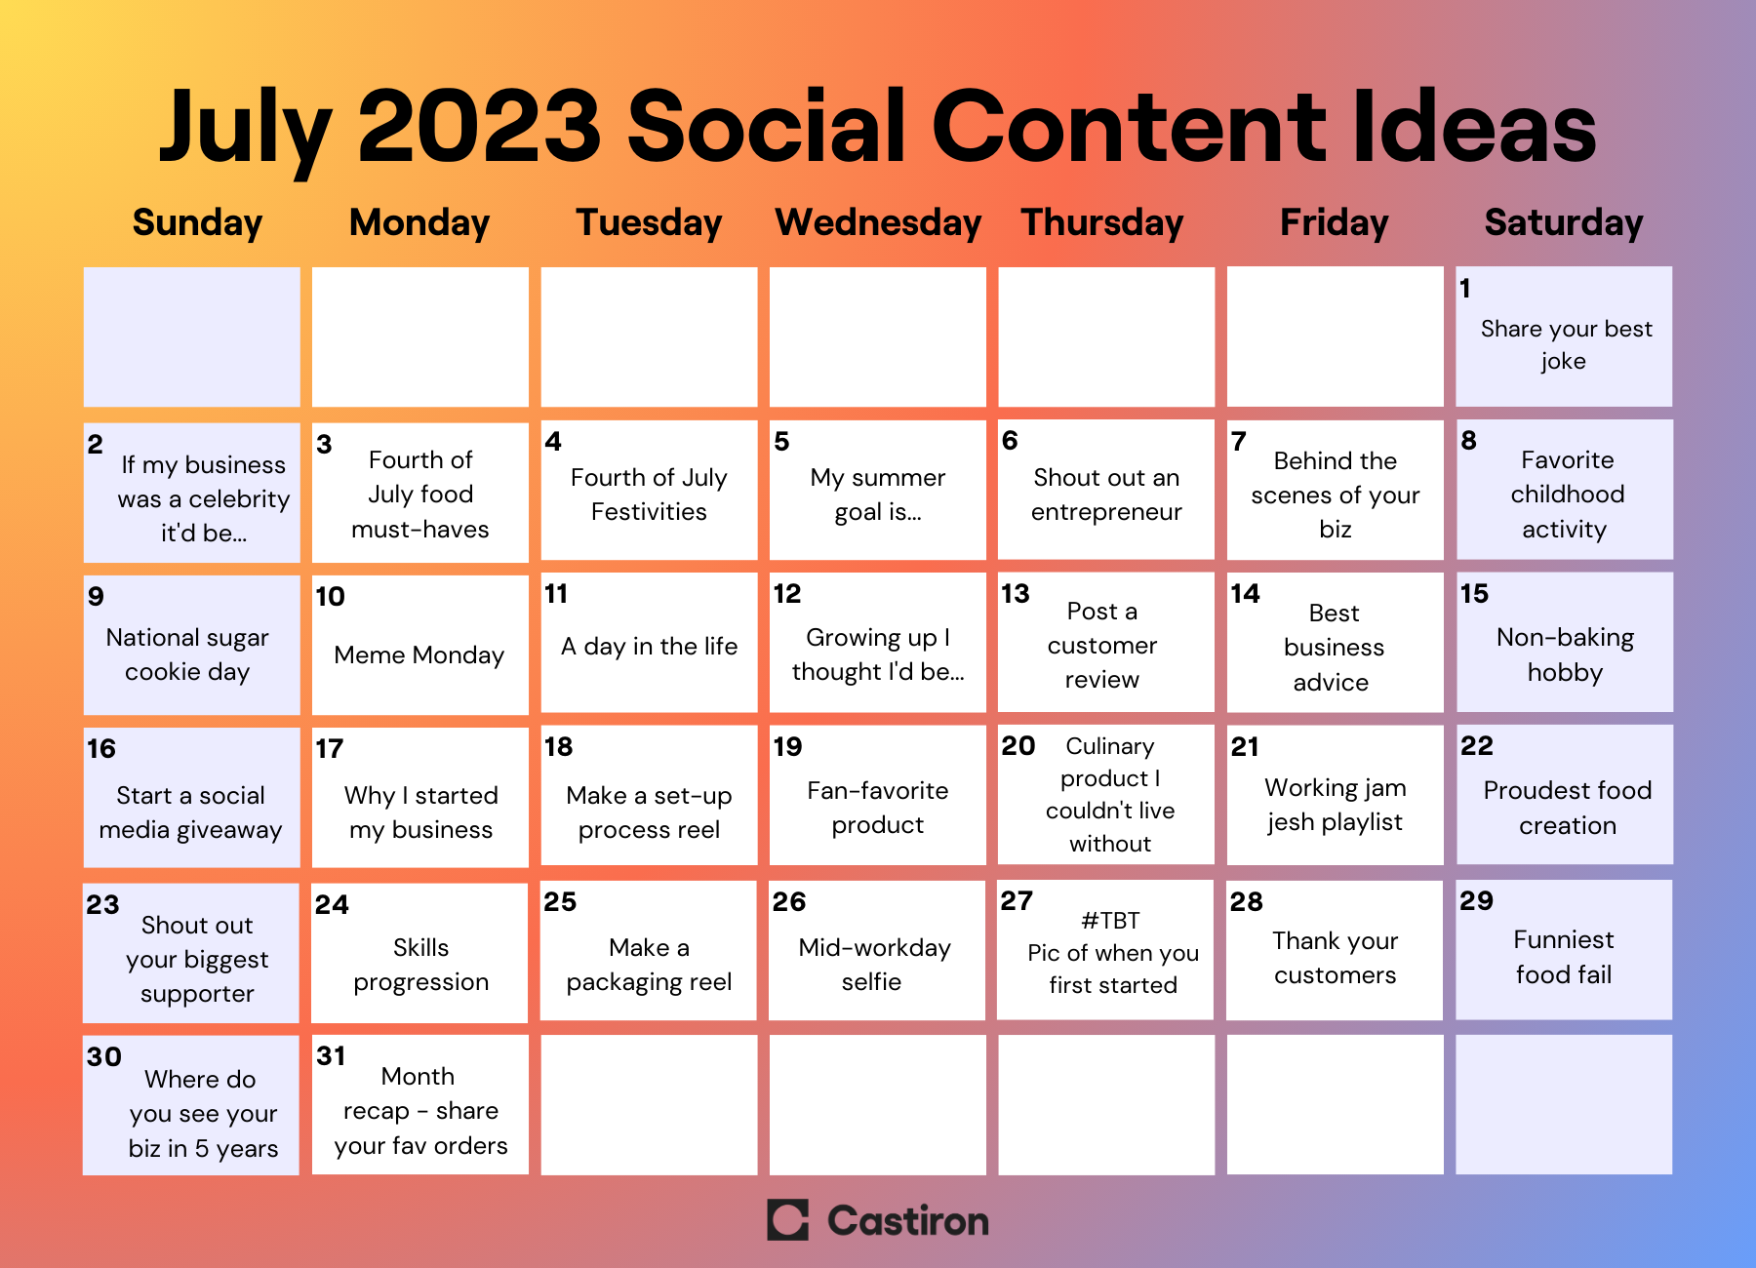

Slide 20

Part 4: Content Creation and Curation (Post creations, Designs/Video Editing, Ad Campaigns over Social Media and Email Ideation and Creation)
Format 1 : Blog Article
Format 2 : Video / Designs editing
Format 3 : Ad Campaigns

Slide 21

Blog Article
Tata Motors: A Pioneer in the Indian Automotive Industry
Tata Motors is one of India's largest automakers, with a history dating back to 1945. The company has a wide range of products, including passenger cars, commercial vehicles, and buses. Tata Motors is also a global player, with operations in over 40 countries.
One of the reasons for Tata Motors' success is its focus on innovation. The company has been a pioneer in the development of new technologies, such as electric vehicles and autonomous driving. Tata Motors is also committed to safety, and its vehicles have consistently been rated among the safest in India.

Slide 22

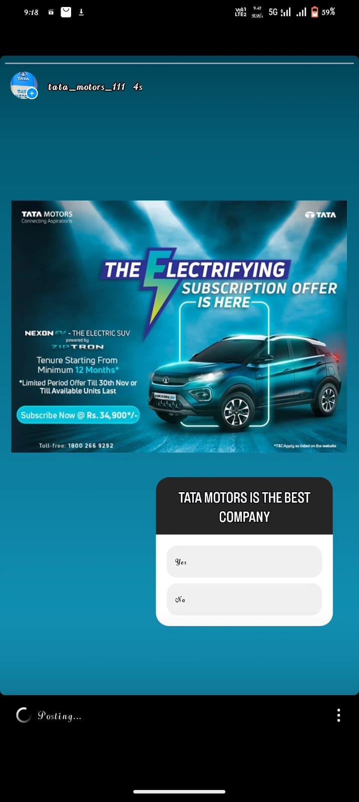
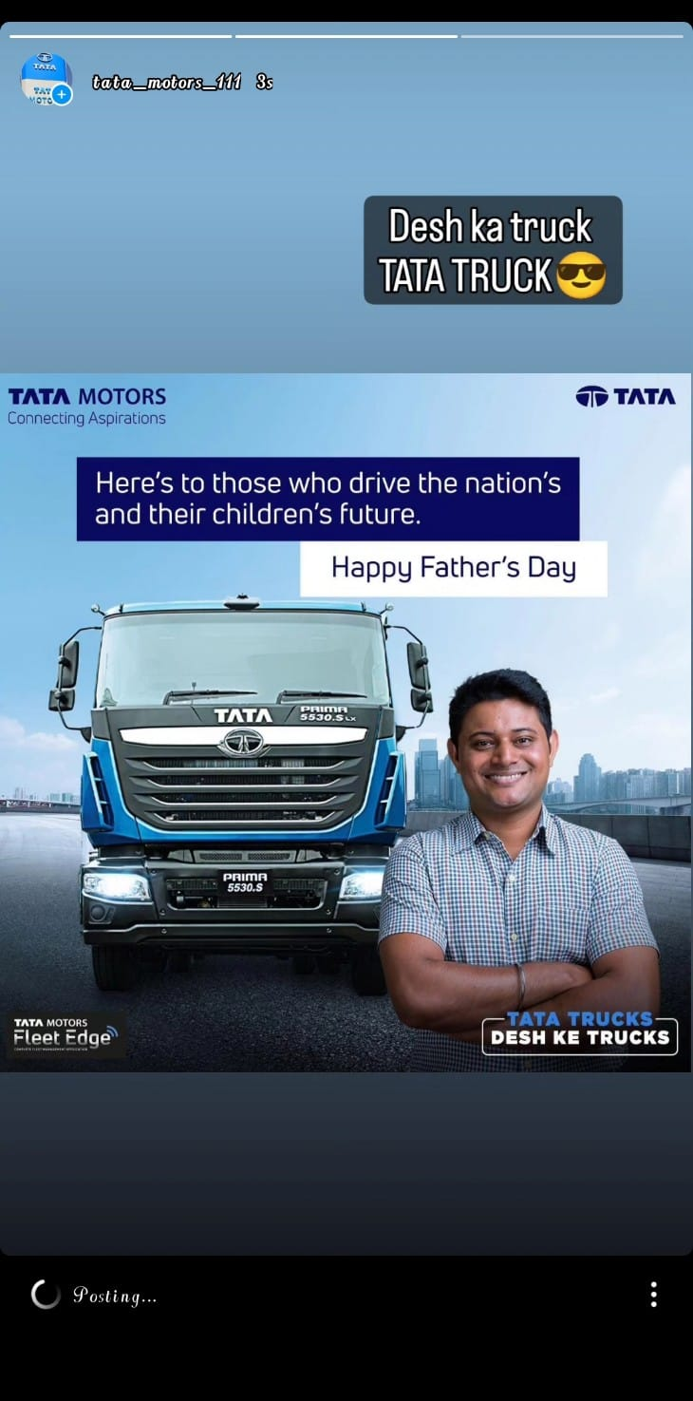
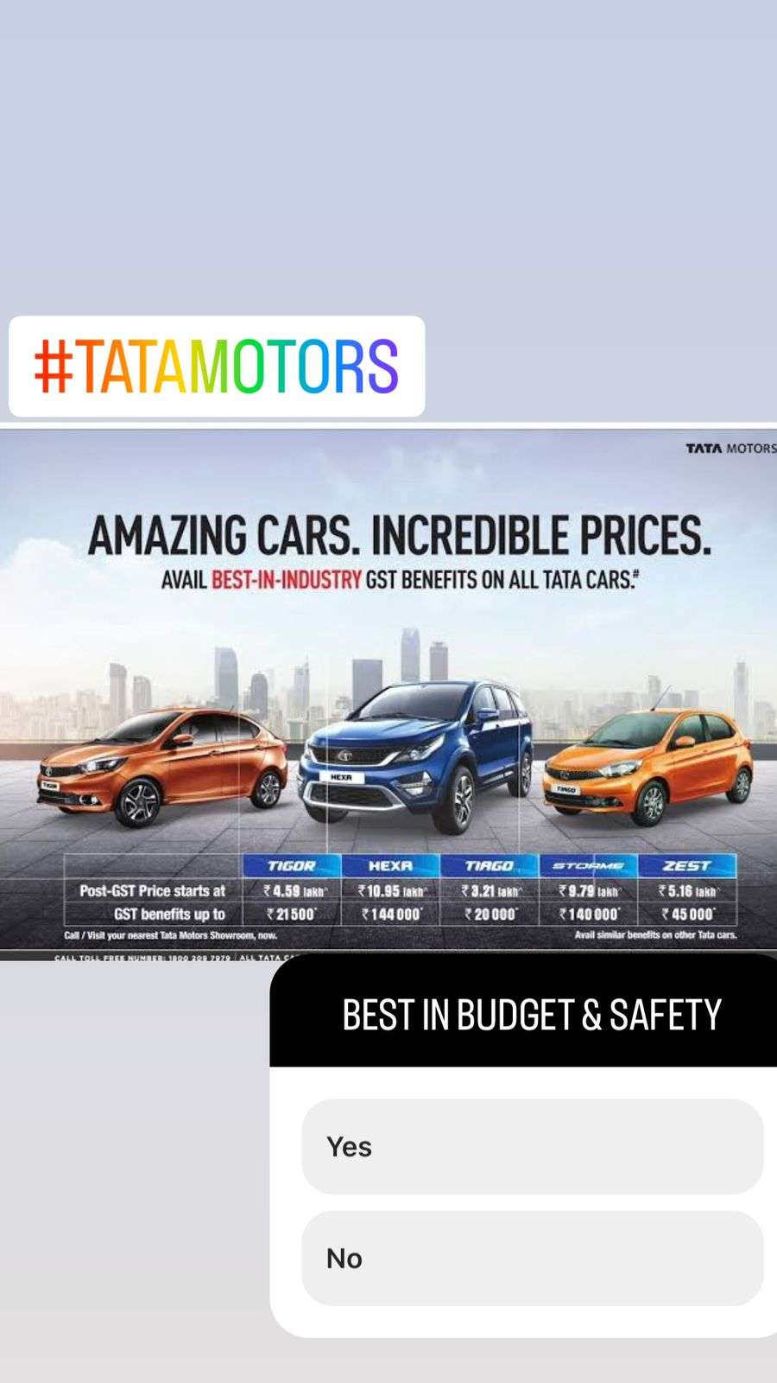
Instagram Story

Slide 23

Part 4: Content Creation and Curation (Post creations, Designs/Video Editing, Ad Campaigns over Social Media and Email Ideation and Creation)
Designs/Video Editing

Slide 24

Social Media Ad Campaigns
LinkedIn :
Tata Motors uses LinkedIn to share a variety of content, including news about new products, company updates, and employee stories. The company also uses LinkedIn to engage with potential customers and partners.
By using LinkedIn targeting, Tata Motors can reach its target audience more effectively and efficiently. This can help the company achieve its marketing goals and grow its business.

Slide 25

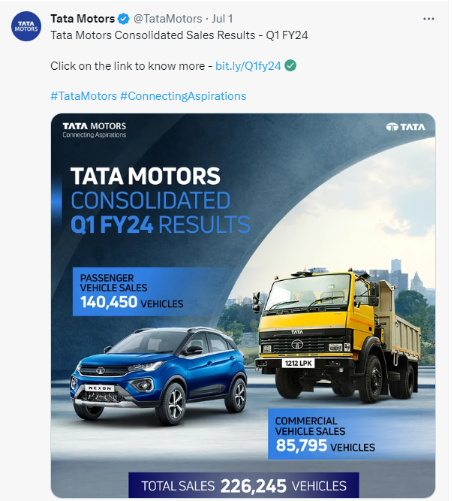
Social Media Ad Campaigns
Twitter :
Tata Motors has a strong brand awareness on Twitter. The company uses the platform effectively to share news, promote its brand, and engage with customers. This has helped Tata Motors to build a strong following of engaged users, which has in turn helped to drive sales.
Middle-class and upper-middle-class Indians: Tata Motors is one of the most popular car brands in India, and its target audience on Twitter is largely made up of people from these social classes. These people are typically interested in new car releases, product information, and customer service.
Business professionals: Tata Motors also targets business professionals on Twitter. These people are interested in learning about Tata Motors' corporate social responsibility initiatives, its partnerships with other businesses, and its latest innovations.

Slide 26
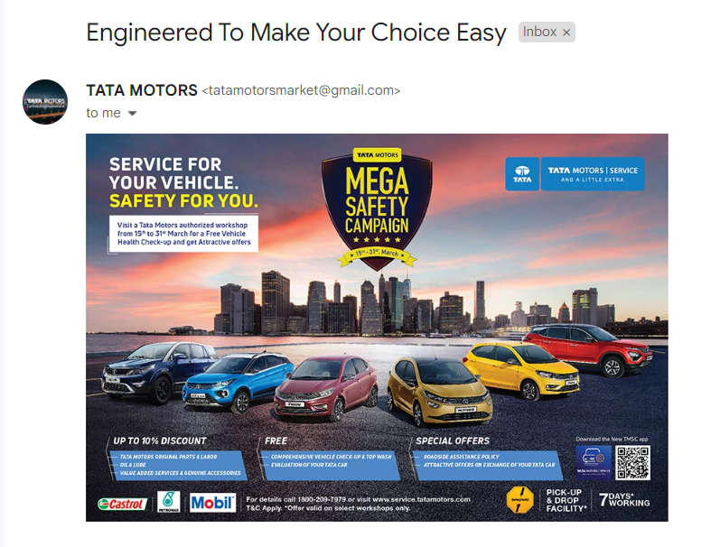
Email Ad Campaign 1 - Brand Awareness

Slide 27
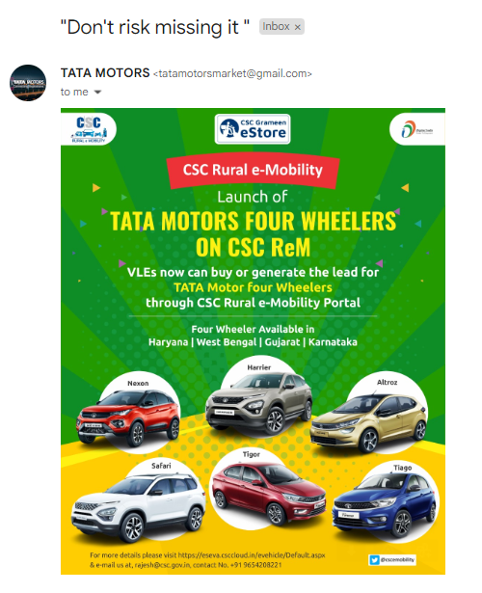
Email Ad Campaign 2 - Lead Generation

Slide 28


